Slide 1





Fake News Detection Using Machine Learning
By
Janaki S

Slide 2
Introduction
Fake news spreads misinformation rapidly, and the goal is to classify news articles as either fake or real, helping to improve media credibility and trustworthiness.

Slide 3
Project Objectives
Analyze news content for authenticity.
Build a machine learning model to detect fake news.
Deploy a user-friendly web application.

Slide 4
Technologies Used
Programming Language: Python
Libraries: Pandas, NumPy
Frameworks: Flask (web app), TensorFlow (deep learning)
Cloud Platforms: AWS/GCP for deployment

Slide 5
Project Workflow
Data Collection: Gather labeled datasets.
Preprocessing: Clean and vectorize text data.
Model Training: Train using Random Forest or Neural Networks.
Evaluation: Test accuracy, precision, and recall.
Deployment: Build a web app for real-time classification.

Slide 6
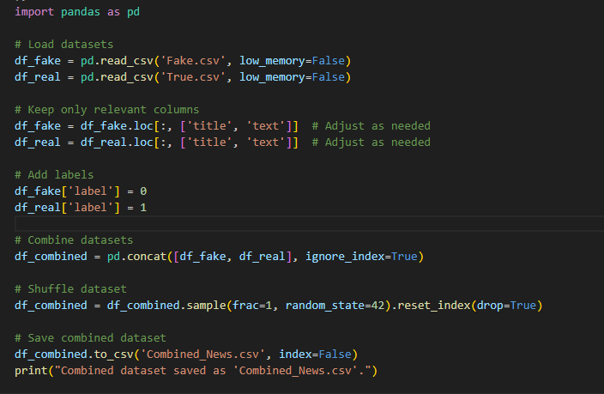
Code
Discuss﻿ion

Slide 7
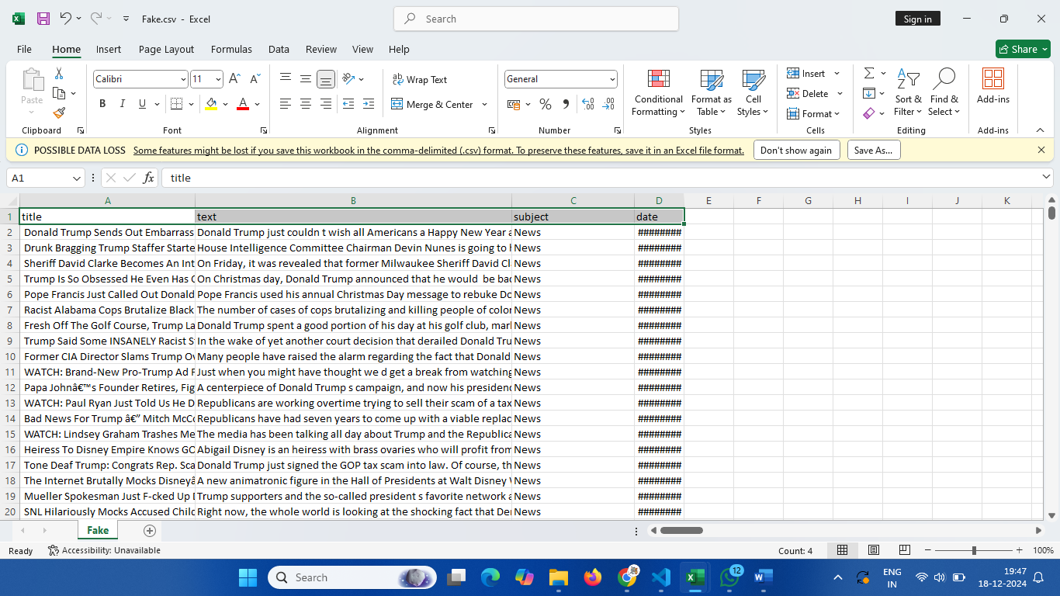
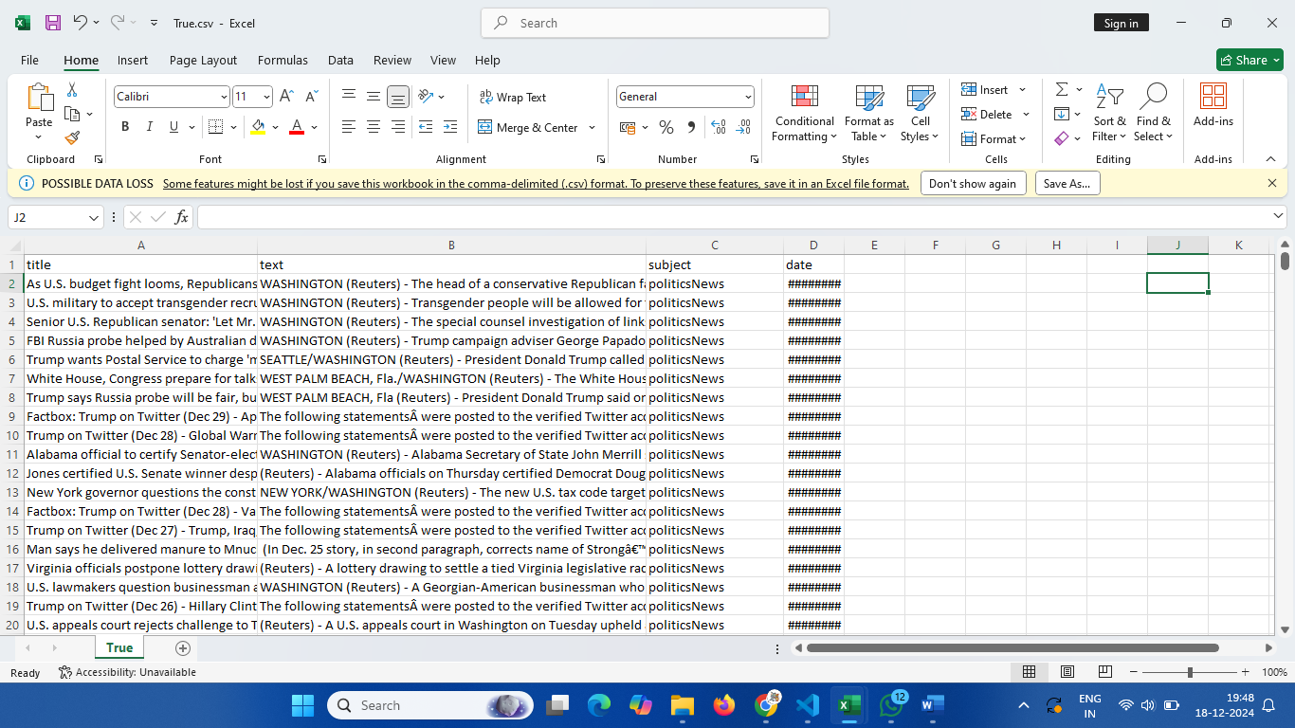
Fake.csv
Data Analysis
True.csv

Slide 8
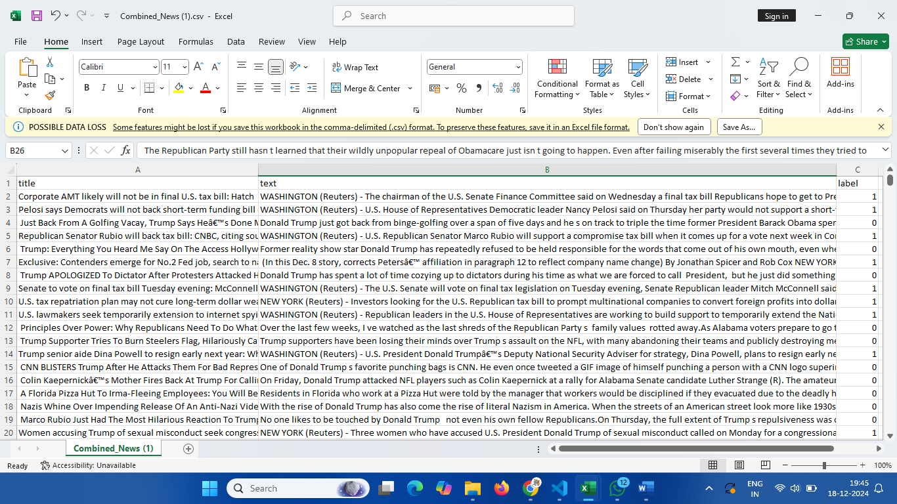
Output
Background
Goals

Slide 9
THANK YOU

